Slide 1
Rest Calls

Slide 2
Consider paths we took:
wordy Java tests
made a printer
made a good printer – not a json: Json test // TODO the json tests
made the inlining – makes it easier to read the whole test better
did multiple conversations
now we can see individual tests, but we can’t see the big picture – so we moved it to the uber test – can delete the other files

Slide 3
Original
@Test public void shouldGetCustomerFromService() { // given accountType = CustomerAccountTypeInfo.builder().account(ACCOUNT_ID).accountType(”PERSONAL").subscription(”MONTHLY").build(); when(responseEntity.getBody()).thenReturn(accountType); // when CustomerAccount result = customerService.retrieveAccount(ACCOUNT_ID); // then CustomerAccount expectedCustomerAccount = new CustomerAccount(ACCOUNT_ID, CustomerPaymentType.MONTHLY, "PERSONAL"); assertThat(result, is(expectedCustomerAccount)); verify(restTemplate, times(1)).exchange(calledUrlCaptor.capture(), eq(HttpMethod.GET), sentHttpEntityCaptor.capture(), any(Class.class)); verifyHeadersAreValid(sentHttpEntityCaptor.getValue().getHeaders()); }

Slide 4
Approval Text
Recorded call to : Conversation Details API
REQUEST
--------------------------------------------------------------------------------
Method : GET
Called Url: /api/v1.2/message/id/500
Headers :
{
"Authorization" : [ "Basic fake" ],
"Cache-Control" : [ "no-cache" ]
}
Body :
null
EXAMPLE RESPONSE
--------------------------------------------------------------------------------
{
"data": [
{
"displayNumber": "500",
"encodedCaseDisposition": 27,
"uuid": "uuid-1",
"createDate": 0,
"responsePortalLink": "/portal/message/500",
"primaryMessage": {
"conversationDisplayId": "500",
"network": "twitter",
"networkInstance": "twitter",
"receiveDate": 0,
"publishDate": 0,
"tags": [
],
"private": true
},
"messages": [
{
"conversationDisplayId": "500",
"network": "twitter",
"networkInstance": "twitter",
"receiveDate": 0,
"publishDate": 0,
"tags": [
],
"private": true
}
],
"tags": [
{
"creator": {
"type": "BOT"
},
"tagId": "34",
"uuid": "uuid2"
}
],
"priority": 4,
"lswPermalink": "/console/bot/500",
"totalResponses": 2,
"hasResponse": false,
"status": "IN_PROGRESS"
}
]
}

Slide 5
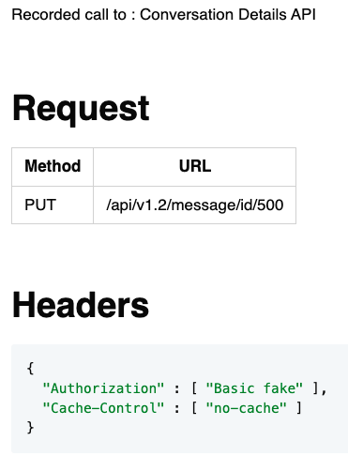
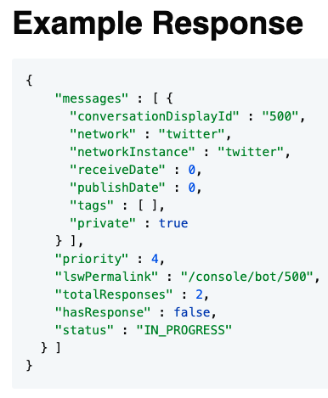
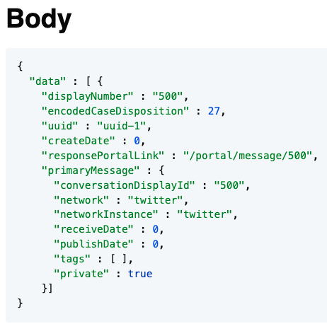
Approval Markdown
2-5 min - Lightning talk?

Slide 6
Conversations

Slide 7
Original
@Test void botIntroducesItselfAndClarifiesIntent() { // given EventNotification message = TestUtils.eventNotification() .userId(UserId.builder().channel(Channel.TEXT).channelId(UUID.randomUUID().toString()).build()) .properties(List.of( new Property("accountId", "1234567"), new Property("code", "411"))) .events(List.of(new MessageEvent(System.currentTimeMillis(), "0", "hi"))).build(); BotNotificationHandler notificationHandler = new BotNotificationHandler(); BotOutboundChannel botOutboundChannel = new BotOutboundChannel(); // when notificationHandler.handle(message); // then BotAction botActions = botOutboundChannel.read(message.getConversationId()); assertThat(botActions.getCommands()) .containsExactly( new SendPlainMessageCommand("Hi there! I'm your virtual assistant."), new SendPlainMessageCommand("What would you like to do today?") ); }

Slide 8
Approvals
@Test void botIntroducesItselfAndClarifiesIntent() { String expected = """ [Customer]: hi [ Bot]: Hi there! I'm your virtual assistant. [ Bot]: What would you like to do today? """; verifyConversation(expected, "hi"); }

Slide 9
TODO
Lada’s tests -> approval test (of the list) -> better printing
Full printed story -> whitespace -> json
Pretty printed json -> inline -> everywhere
everywhere -> single instance -> some can’t convert
dual conversations (.and) -> some can’t convert v2 -> setting state

Slide 10
Better Testing with Approvals
Llewellyn Falco
Lada Kesseler

Slide 11
The story so far
Lada: lead developer working on the message bot application
Llewellyn: technical coach working with Lada and work on some tests

Slide 12

...later that week...

Slide 13
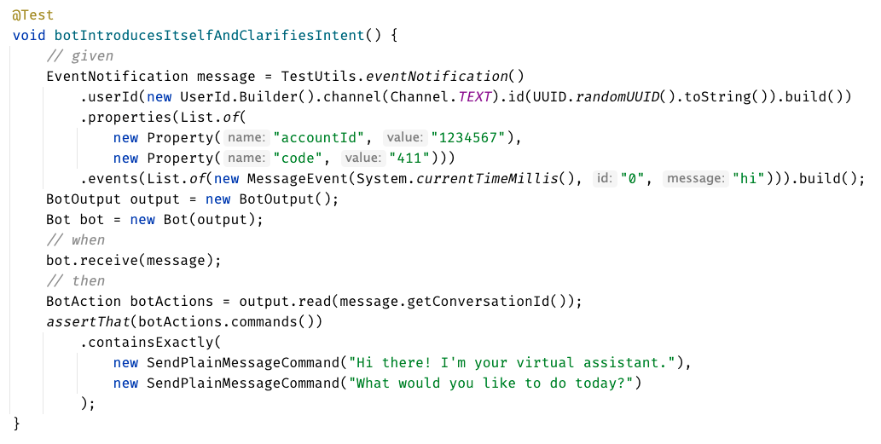
Original Test

Slide 14
?? WHAT IS THIS ??
Chat
[Customer]
hi
[Bot]
Hi there! I'm your virtual assistant.
What would you like to do today?

Slide 15
// Create side (0,0) – (3,4)
// Verify length
Whiteboard
English
Testing Circle
Result
Code
Side (0,0) – (3,4) length = 5
Side s = new Side(0,0,3,4);
Approvals.Verify(s + “ length = “ +s.Length);

Slide 17
// Create side (0,0) – (3,4)
// Verify length
Whiteboard
English
Testing Circle
Result
Code
Side (0,0) – (3,4) length = 5
Side s = new Side(0,0,3,4);
Approvals.Verify(s + “ length = “ +s.Length);

Slide 18
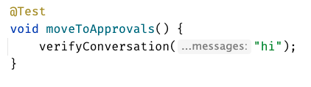
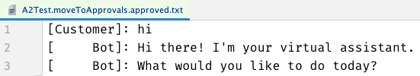
Chat
[Customer]
hi
[Bot]
Hi there! I'm your virtual assistant.
What would you like to do today?
Customer says ‘hi’
verify the conversation

Slide 19
...later that week...

Slide 20
Formatting
[Customer]: hi [Bot]: Hi there! I'm your virtual assistant. [Bot]: What would you like to do today?
[Customer]: hi [ Bot]: Hi there! I'm your virtual assistant. [ Bot]: What would you like to do today?

Slide 21
Formatting
[Customer]: hi [Bot]: Hi there! I'm your virtual assistant. [Bot]: What would you like to do today? [Customer]: hi [Bot]: Hmmm, tell me a little more so I can help you. What would you like to do today? [Customer]: hi [Bot]: Let me try to help you. [Bot]: Are you a customer? 1) Yes, I'm a customer 2) No, I'm not
[Customer]: hi [ Bot]: Hi there! I'm your virtual assistant. [ Bot]: What would you like to do today? [Customer]: hi [ Bot]: Hmmm, tell me a little more so I can help you. [ ]: What would you like to do today? [Customer]: hi [ Bot]: Let me try to help you. [ Bot]: Are you a customer? [ ]: 1) Yes, I'm a customer [ ]: 2) No, I'm not

Slide 22
?? WHAT IS THIS ??
Chat
[Customer]
hi
[Bot]
Hi there! I'm your virtual assistant.
What would you like to do today?
[Customer]
pay bill
[Bot]
Are you a customer?
Yes, I'm a customer No, I'm not

Slide 23
...later that week...

Slide 24
// Create side (0,0) – (3,4)
// Verify length
Whiteboard
English
Testing Circle
Result
Code
Side (0,0) – (3,4) length = 5
Side s = new Side(0,0,3,4);
Approvals.Verify(s + “ length = “ +s.Length);

Slide 25
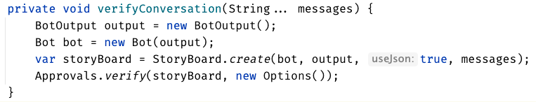

Slide 26
testing circle

Slide 28
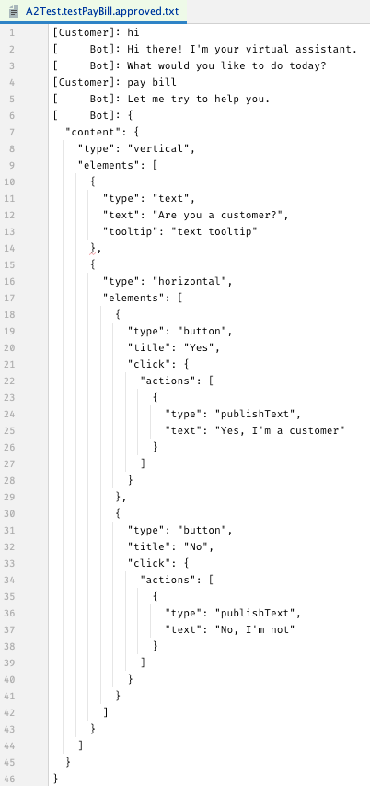
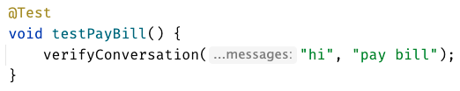

Slide 29
[Customer]: hi [ Bot]: Hi there! I'm your virtual assistant. [ Bot]: What would you like to do today? [Customer]: pay bill [ Bot]: Let me try to help you. [ Bot]: { "content": { "type": "vertical", "elements": [ { "type": "text", "text": "Are you a customer?", "tooltip": "text tooltip" }, { "type": "horizontal", "elements": [ { "type": "button", "title": "Yes", "click": { "actions": [ { "type": "publishText", "text": "Yes, I'm a customer" } ] } }, { "type": "button", "title": "No", "click": { "actions": [ { "type": "publishText", "text": "No, I'm not" } ] } } ] } ] } }

Slide 30
[Customer]: hi [ Bot]: Hi there! I'm your virtual assistant. [ Bot]: What would you like to do today? [Customer]: pay bill [ Bot]: Let me try to help you. [ Bot]: Are you a customer? [ ]: 1) Yes, I'm a customer [ ]: 2) No, I'm not

Slide 31
...later that week...

Slide 32
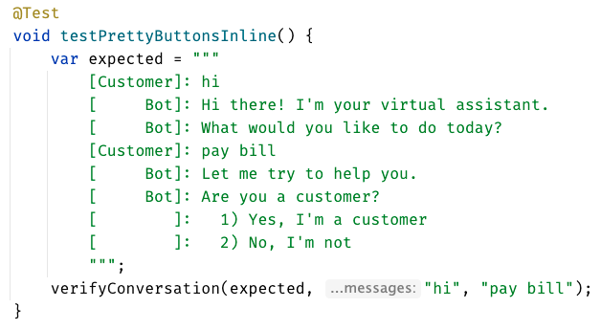
inline - everything in test

Slide 33
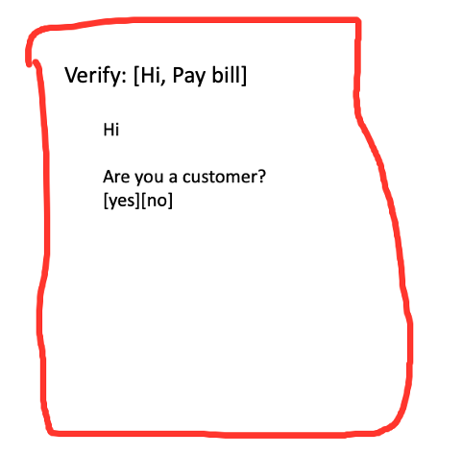
lots of tests – most of them work
different test – in old test format

Slide 34
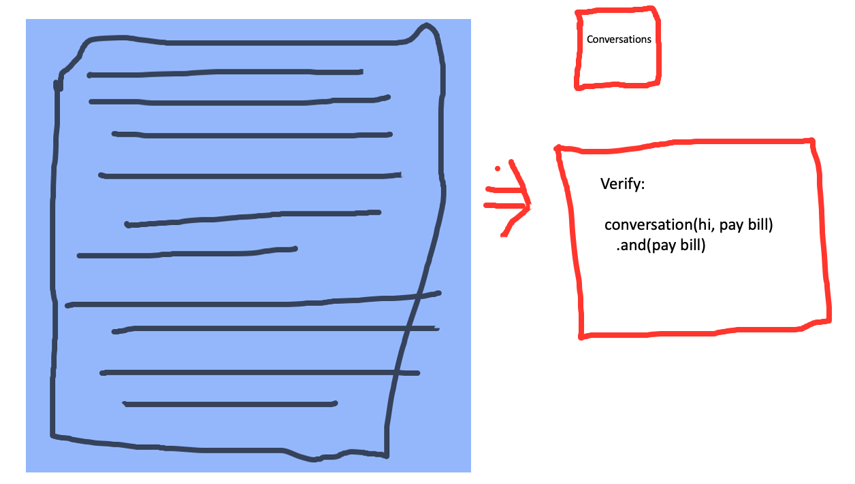

Slide 35
lots of tests – most of them work
different test – in old test format

Slide 36
lots of tests –all of them work
consistency in all of our tests

Slide 37
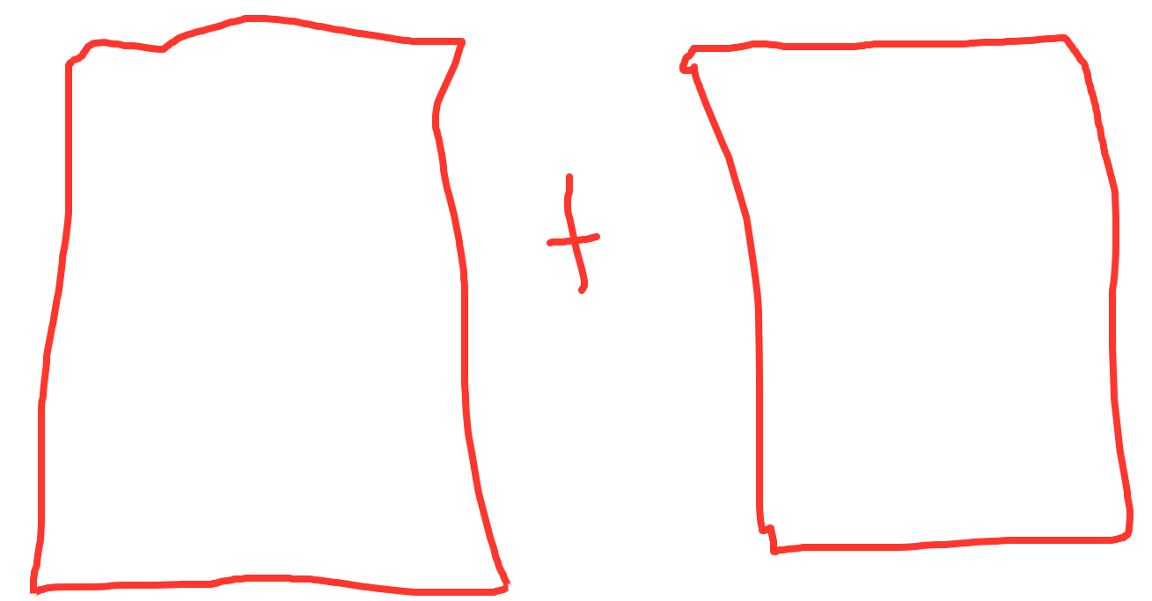
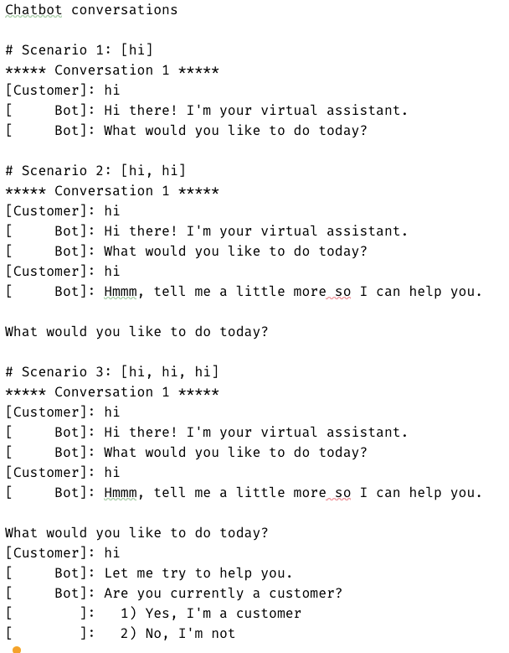
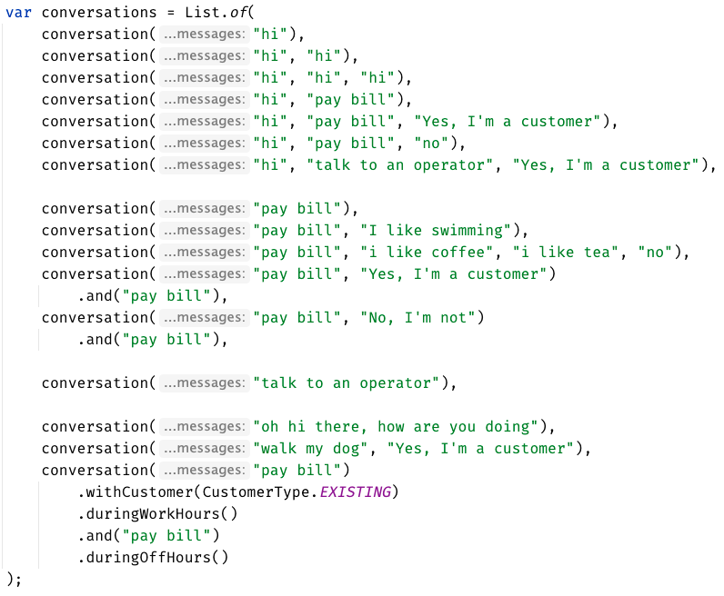
Much easier to see the big picture
Approved
how do they relate to each other? what’s the differences? grouping

Slide 38
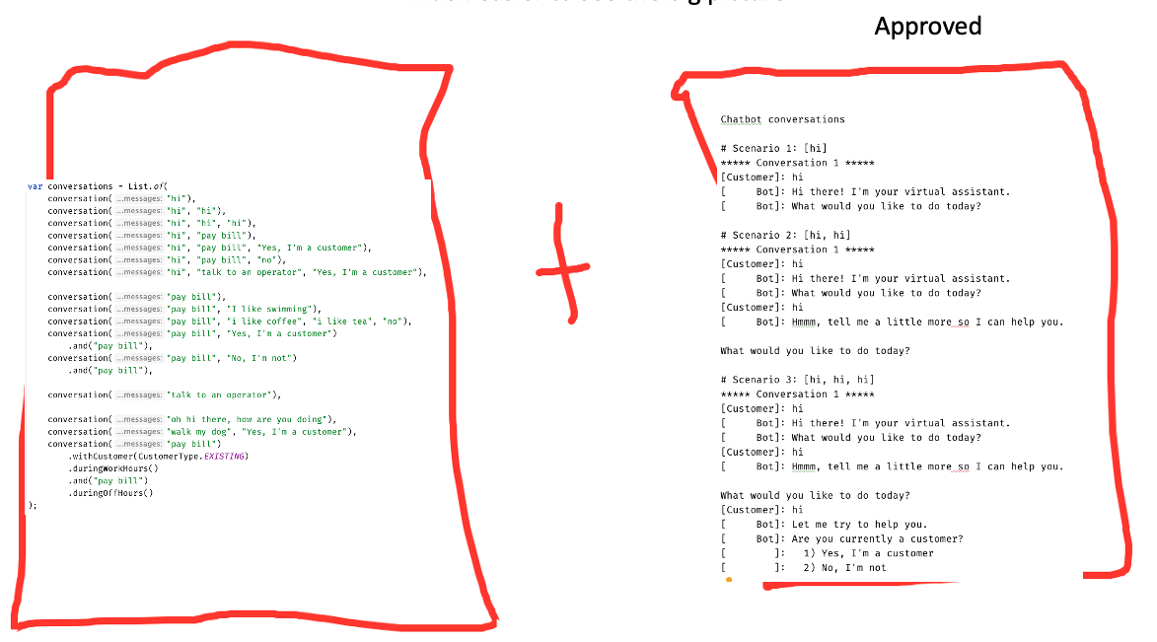
Much easier to see the big picture
we still have this one
in the new format
messy setup – needed config
messy setup

Slide 39
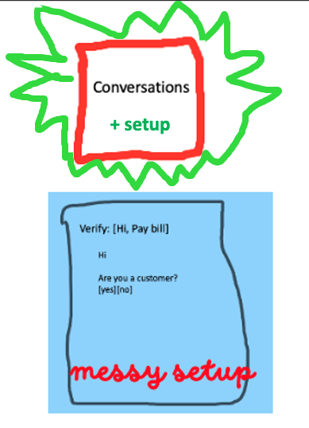

Slide 40
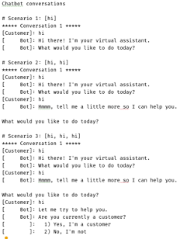
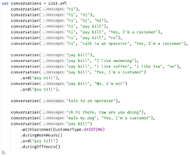
Much easier to see the big picture
Approved
how do they relate to each other? what’s the differences? grouping

Slide 41
can see only
up to here
foggy
as the details disappear,
we get to see the next layer
person

Slide 42
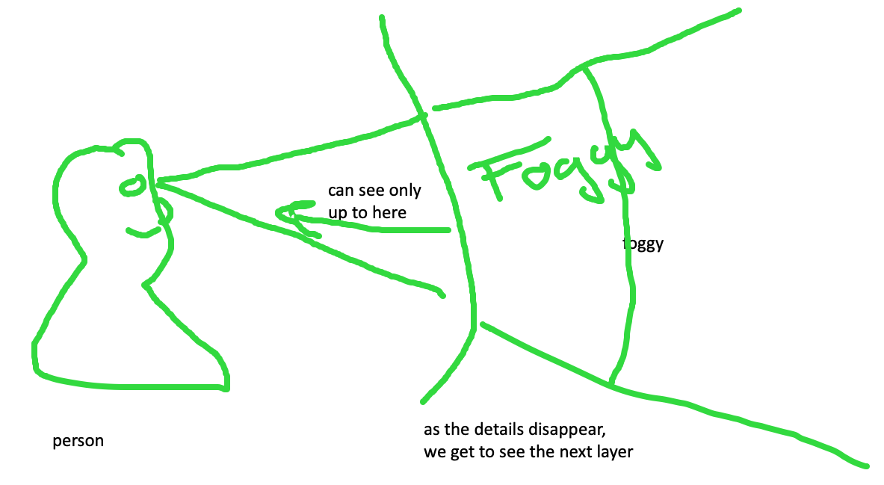
feedback loop – too hard and impossible is the same thing, stop to look

Slide 43
